Slide 1
UNIT-II
PART-1: Stacks and Queues
  Stacks, Stacks using dynamic arrays
  Queues, Circular Queues using dynamic arrays
  A Mazing Problem
  Evaluation of Expressions
    Evaluating Postfix Expression
    Infix to Postfix
PART-2: Linked Lists
  Singly Linked Lists and Chains
  Linked Stacks and Queues
  Polynomials, Sparse matrices
  Operations for Circularly linked lists
  Doubly Linked Lists

Slide 2
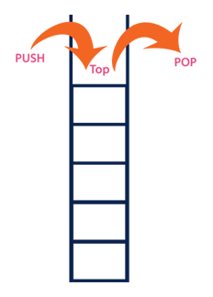
1. Stacks, Stacks using dynamic arrays
Stack is a linear data structure in which the insertion and deletion operations are performed at only one end.
In a stack, adding and removing of elements are performed at single position which is known as "top".
That means, new element is added at top of the stack and an element is removed from the top of the stack.
In stack, the insertion and deletion operations are performed based on LIFO (Last In First Out) principle.

Slide 3
Stacks, Stacks using dynamic arrays
Now, whenever an implementation of stack is considered its size is pre-determined or fixed. Even though it is dynamically allocated, still once it is made its size cannot be changed. And hence a condition called “stack full” arises.
But what if a stack can grow as more elements are inserted or more elements are going to be inserted in future.
Growable Stack is the concept of allocating more memory such that “stack full” condition does not arises easily.
A Dynamic or Growable array based Stack can be implemented by allocating new memory larger than previous stack memory and copying elements from old stack to new stack and then change the name of old stack to new stack.

Slide 4
Stacks, Stacks using dynamic arrays
Basic Operations:
  push() − Pushing (storing) an element on the stack.
  pop() − Removing (accessing) an element from the stack.
  peek() − get the top data element of the stack, without removing it.
  isFull() − check if stack is full.
  isEmpty() − check if stack is empty.
Implementation:
int peek() { return stack[top]; }
bool isfull() { if (top == MAXSIZE) return true;
else return false; }
bool isempty() { if(top == -1) return true;
else return false; }

Slide 5
Stacks, Stacks using dynamic arrays
Push Operation: involves a series of following steps −
  Step 1 − Checks if the stack is full.
  Step 2 − If the stack is full, produces an error and exit.
  Step 3 − If the stack is not full, increments top to point next empty space.
  Step 4 − Adds data element to the stack location, where top is pointing.
  Step 5 − Returns success.
void push (int data) {
if (!isFull()) { top = top + 1; stack[top] = data; }
else { printf("Could not insert data, Stack is full.\n"); } }.
int pop (int data) {
if (!isempty()){ data = stack[top]; top = top - 1; return data; }
else { printf("Could not retrieve data, Stack is empty.\n"); }

Slide 6

2. Queues, Circular Queues using dynamic arrays
Queue is a linear data structure in which the insertion and deletion operations are performed at two different ends.
The insertion is performed at one end and deletion is performed at other end. In a queue data structure, the insertion operation is performed at a position which is known as 'rear' and the deletion operation is performed at a position which is known as 'front'.
In queue data structure, the insertion and deletion operations are performed based on FIFO (First In First Out).
In a queue data structure, the insertion operation is performed using a function called "enQueue()" and deletion operation is performed using a function called "deQueue()".

Slide 7
Queues, Circular Queues using dynamic arrays
Few more functions are required to make the above-mentioned queue operation efficient. These are −
  peek() − Gets the element at the front of the queue without removing it.
  isfull() − Checks if the queue is full.
  isempty() − Checks if the queue is empty.
In queue, we always dequeue data, pointed by front pointer and while enqueing data in the queue we take help of rear pointer.
Enqueue Operation: comparatively difficult to implement than that of stacks. It uses steps insert data into a queue:
  Step 1 − Check if the queue is full.
  Step 2 − If the queue is full, produce overflow error and exit.
  Step 3 − If the queue is not full, increment rear pointer to point the next empty space.
  Step 4 − Add data element to the queue location, where the rear is pointing.
  Step 5 − return success.

Slide 8
Queues, Circular Queues using dynamic arrays
Dequeue Operation: Accessing data from the queue is a process of two tasks − access the data where front is pointing and remove the data after access. The following steps are taken −
  Step 1 − Check if the queue is empty.
  Step 2 − If the queue is empty, produce underflow error and exit.
  Step 3 − If the queue is not empty, access the data where front is pointing.
  Step 4 − Increment front pointer to point to the next available data element.
  Step 5 − Return success
Implementation:
int peek() { return queue[front]; }
bool isfull() { if (rear == MAXSIZE - 1)
return true;
else
return false; }

Slide 9
Queues, Circular Queues using dynamic arrays
bool isempty() { if (front < 0 || front > rear)
return true;
else return false; }
int enqueue(int data) { if (isfull()) return 0;
rear = rear + 1;
queue[rear] = data;
return 1; }
int dequeue() { if (isempty()) return 0;
int data = queue[front];
front = front + 1;
return data; }

Slide 10
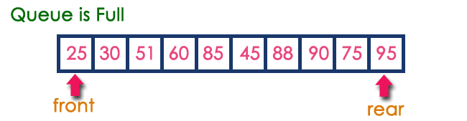
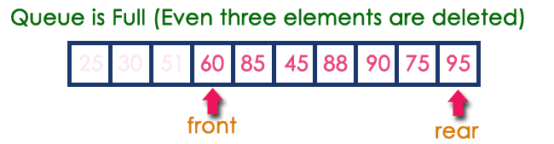
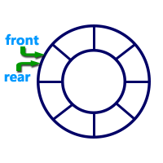
Circular Queues…
After inserting all the elements into the queue.
Now consider the following situation after deleting three elements from the queue...
Circular Queue is a linear data structure in which the operations are performed based on FIFO (First In First Out) principle and the last position is connected back to the first position to make a circle.
Graphical representation:

Slide 11
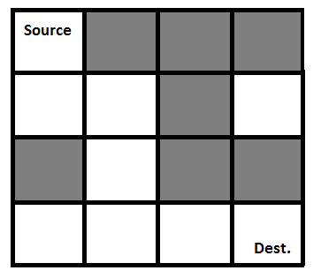
3. A Mazing Problem
A Maze is given as N*N binary matrix of blocks where source block is the upper left most block i.e., maze[0][0] and destination block is lower rightmost block i.e., maze[N-1][N-1].
A rat starts from source and has to reach the destination. In simple case, the rat can move only in two directions: forward and down. However in complex version, the rat can move in 4 directions with a limited number of moves.
In the maze matrix, 0 means the block (dead end) and 1 means the block (open edn) can be used in the path from source to destination.
Example: Simple Maze (4x4)
Gray Blocks = 0 = dead end
White Blocks = 1 = Open end

Slide 12

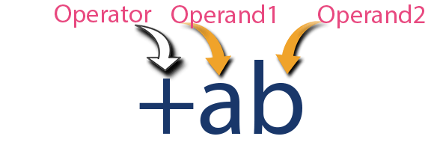
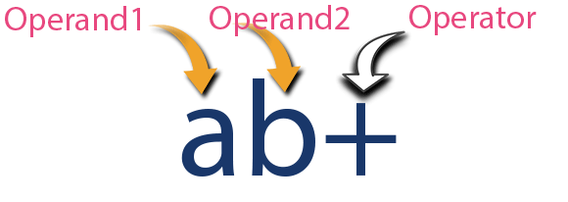
4. Evaluation of Expressions
An expression is a collection of operators and operands that represents a specific value. In this definition, operator is a symbol which performs a particular task like arithmetic operation or logical operation or conditional operation etc.
Operands are the values on which the operators can perform the task. Here operand can be a direct value or variable or address of memory location.
Based on the operator position, expressions are divided into 3 types:
  Infix Expression:
  Prefix Expression:
  Postfix Expression:

Slide 13
Postfix Expression Evaluation
A postfix expression can be evaluated using the Stack data structure by using following steps…
  Read all the symbols one by one from left to right in the given Postfix Expression until $ symbol.
  If the reading symbol is operand, then push it on to the Stack.
  If the reading symbol is operator (+ , - , * , / etc.,), then perform TWO pop operations and store the two popped operands in two different variables (operand1 and operand2). Then perform operation using operand1 and operand2 and push result back on to the Stack.
  Finally! perform a pop operation and display the popped value as final result.
Example: Consider the following Expression...

Slide 14
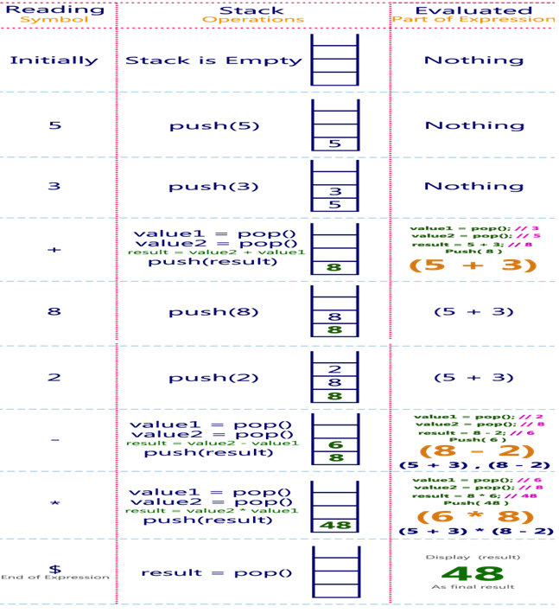
Postfix Expression Evaluation
Example-1

Slide 15
Expression Conversion (Infix to Postfix)
To convert Infix Expression into Postfix Expression using a stack data structure, We can use the following steps...
  Read all the symbols one by one from left to right in the given Infix Expression until $ symbol.
  If the reading symbol is operand, then directly print it to the result (Output).
  If the reading symbol is left parenthesis '(', then Push it on to the Stack.
  If the reading symbol is right parenthesis ')', then pop all the contents of stack until respective left parenthesis is poped and print each poped symbol to the result.
  If the reading symbol is operator (+ , - , * , / etc.,), then push it on to the Stack. However, first pop the operators which are already on the stack that have higher or equal precedence than current operator and print them to the result.
Example: Consider the following Infix Expression:
( A + B ) * ( C - D ) Postfix Expression is: A B + C D - *

Slide 16
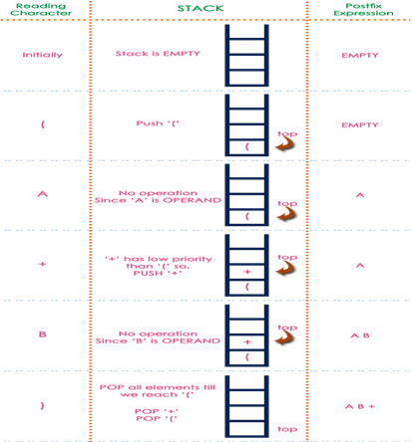
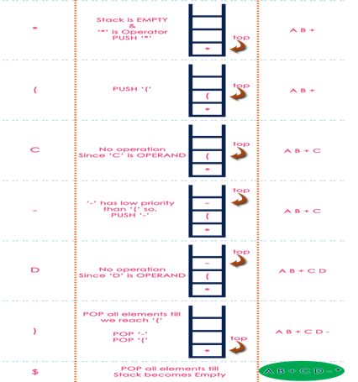
Conversion of Infix to Postfix Expression…
Ex-1: Infix: (A + B) * (C - D) Postfix: A B + C D - *

Slide 17


5. Singly Linked Lists (SLL) and Chains
When we want to work with unknown number of data values, we use a linked list data structure to organize that data.
Linked list is a linear data structure that contains sequence of elements such that each element links to its next element in the sequence. Each element in a linked list is called as "Node".
Every "Node" contains two fields, data and Link. The data field is used to store actual value of that node and Link field is used to store the address of the next node in the sequence.
The Linked Lists are classified in to: SLL, CLL, and DLL
The graphical representation of a node in a single linked list is as follows...

Slide 18
Singly Linked Lists Operations
PushFront(Key) - add to front
Key TopFront() - return front item
PopFront() - remove front item
PushBack(Key) - add to back
Key TopBack() - return back item
PopBack() - remove back item
Boolean Find(Key) - is key in list?
Erase(Key) - remove key from list
Boolean Empty() - empty list?
AddBefore(Node, Key) - adds key before node
AddAfter(Node, Key) - adds key after node
Displaylist(Head) - display items in SLL

Slide 19


Singly Linked Lists Operations…
Node definition
struct node {
int key; //Data of the node
struct node *next; //Address of the next node i.e. link to next node
}*head, *tail;
node createnode(key) {
node ← (struct node *)malloc(sizeof(struct node));
node.key ← key;
node.next ← NULL; }
PushFront(key) {
node ←createnode(key);
node.next ← head;
head ← node;
if tail = NULL: tail ← head; }

Slide 20
Singly Linked Lists Operations…
PushBack(key) {
  node ←createnode(key)
  if tail = NULL: head ← tail ← node
  else: tail .next ← node, tail ← node }
AddAfter(node, key) {
  node2 ←createnode(key);
  node2.next ← node.next
  node.next ← node2
  if tail = node: tail ← node2 }
AddBefore(node, key) {
  node2 ←createnode(key);
  while p.next.next != nil: { t= p; p ← p.next }
  node2.next ← p
  t.next ← node2}

Slide 21
Singly Linked Lists Operations…
PopFront() {
  if head = NULL: ERROR: empty list
  head ← head.next
  if head = NULL: tail ← NULL }
PopBack() {
  if head = NULL : ERROR- empty list
  if head = tail: head ← tail ←nil
  else: p ← head
  while p.next.next != nil: p ← p.next
  p.next ← NULL; tail ← p }
DisplayList(head) {
  if head = NULL: ERROR- empty list
  else: p ← head
  while p.next != NULL:
  print key; p ← p.next;}

Slide 22
6. Linked Stacks and Queues
Linked Stack: The major problem with the stack implemented using array is, it works only for fixed number of data values.
When we don't know the size of data which we are going to use, a stack data structure can be implemented by using linked list, that means, stack implemented using linked list works for variable size of data.
In linked list implementation of a stack, every new element is inserted as 'top' element. Whenever we want to remove an element from the stack, simply remove the node which is pointed by 'top' by moving 'top' to its next node in the list. The next field of the first element must be always NULL.
In stack, the insertion and deletion operations are performed based on LIFO (Last In First Out) principle.

Slide 23
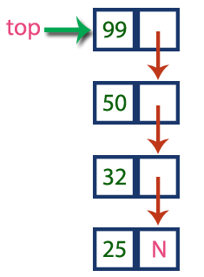
Linked Stacks and Queues…
Example:
In above example, the last inserted node is 99 and the first inserted node is 25. The order of elements inserted is 25, 32,50 and 99.
Stack Operations:
  push() : Insert the element into linked list nothing but which is the top node of Stack.
  pop() : Return top element from the Stack and move the top pointer to the second node of linked list or Stack.
  peek(): Return the top element.
  display(): Print all element of Stack.

Slide 24
Linked Stacks and Queues…
Stack Implementation:
struct node {
int data;
struct node* next;
}*top;
void push (int data) { // create new node temp and allocate memory
struct node* temp;
temp = (struct node *)malloc(sizeof(struct node));;
temp->data = data;
temp->next = top;
top = temp;
}

Slide 25

Linked Stacks and Queues…
Linked Queue: The major problem with the queue implemented using array is, it works only for fixed number of data values.
When we don't know the size of data which we are going to use, a queue data structure can be implemented by using linked list, that means, queue implemented using linked list works for variable size of data.
In linked list implementation of a queue, every element is inserted from rear end and removed from front end.
Example:
In above example, the last inserted node is 50 (pointed by 'rear’) and the first inserted node is 10 (pointed by 'front’). The order of elements inserted is 10, 15, 22 and 50.

Slide 26
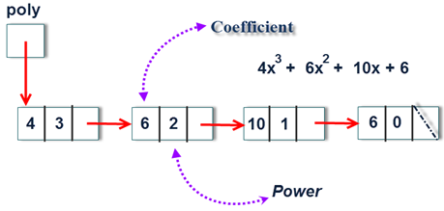
7. Polynomials, Sparse matrices, Equivalence Classes
Polynomials: A polynomial also be represented by using single linked list. Since each term of polynomial contain two items i.e. coefficient and exponent. The structure of the polynomial term defined as:
Struct polynomial {
int coefficient;
int exponent;
struct polynomial *next;
};
Example:

Slide 27
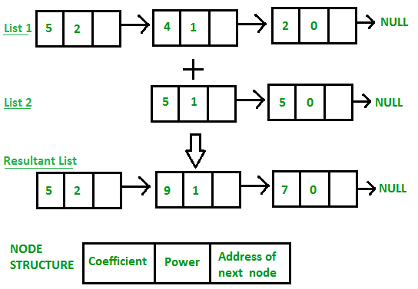
Polynomials, Sparse matrices, Equivalence Classes …
Polynomial Addition Example:
Input: 1st number = 5x^2 + 4x^1 + 2x^0
  2nd number = 5x^1 + 5x^0
  Output: 5x^2 + 9x^1 + 7x^0

Slide 28
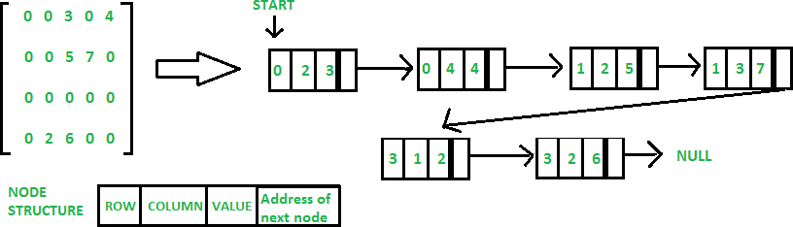
Polynomials, Sparse matrices, Equivalence Classes …
Sparse matrices: In linked list, each node has four fields. These four fields are defined as:
  Row: Index of row, where non-zero element is located
  Column: Index of column, where non-zero element is located
  Value: Value of the non zero element located at index – (row, column)
  Next node: Address of the next node
For example, the given sparse matrix represented as:

Slide 29
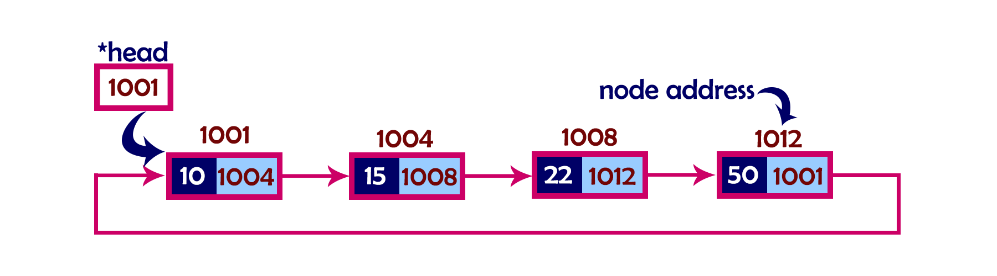
8. Operations for Circularly linked lists
In single linked list, every node points to its next node in the sequence and the last node points NULL.
But in circular linked list, every node points to its next node in the sequence but the last node points to the first node in the list.
That means circular linked list is similar to the single linked list except that the last node points to the first node in the list.
OPERATION OF CIRCULAR LINKED LIST
  Adding elements in the circular linked list.
  Deleting element from the circular list.
  Displaying elements from the circular list.
Example:

Slide 30
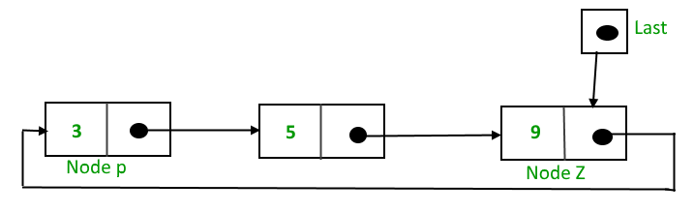
Operations for Circularly linked lists …
Insertion: For insertion of node in the beginning we need traverse the whole list. Also, for insertion and the end, the whole list has to be traversed.
If instead of start pointer we take a pointer to the last node then in both the cases there won’t be any need to traverse the whole list. So insertion in the begging or at the end takes constant time irrespective of the length of the list. A node can be added below ways:
  In an empty list
  At the beginning of the list
  At the end of the list
  In between the nodes

Slide 31
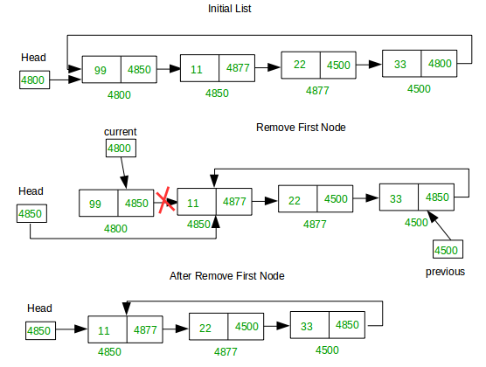
Operations for Circularly linked lists …
Deletion: In a circular linked list, the deletion operation can be performed in following three ways...
  Beginning of the list, Ending of the list, Deleting a Specific Node
Deleting from Beginning of the list:

Slide 32
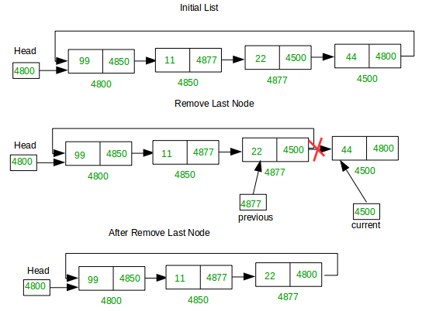
Operations for Circularly linked lists …
Deleting from End of the list:

Slide 33
Operations for Circularly linked lists …
Display / Traverse CLL: In a conventional linked list, we traverse the list from the head node and stop the traversal when we reach NULL. In a circular linked list, we stop traversal when we reach the first node again.
void printList(struct Node *first) {
struct Node *temp = first;
if (first != NULL) // If linked list is not empty
{
do // Keep printing nodes till we reach the first node again
{
printf("%d ", temp->data);
temp = temp->next;
} while (temp != first);
}
}

Slide 34
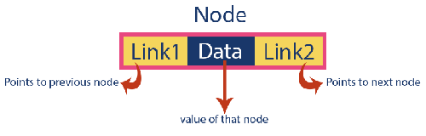

9. Doubly Linked Lists (DLL)
In a single linked list, every node has link to its next node in the sequence. So, we can traverse from one node to other node only in one direction and we can not traverse back.
In double linked list, every node has link to its previous node and next node. So, we can traverse forward by using next field and can traverse backward by using previous field.
Every node in a double linked list contains three fields and they are shown in the following figure.
Example:

Slide 35
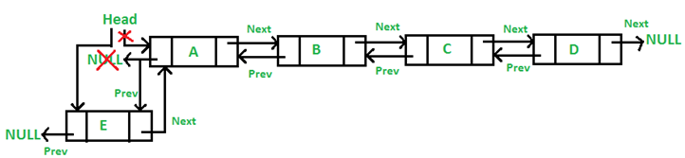
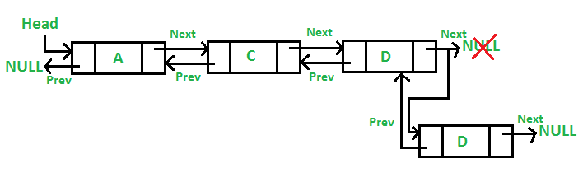
Doubly Linked Lists…
Operations on DLL: Insertion, Deletion and Display
Insertion: At the front of the DLL: A 5 step process
Insertion: At the end of the DLL: A 7 step process

Slide 36
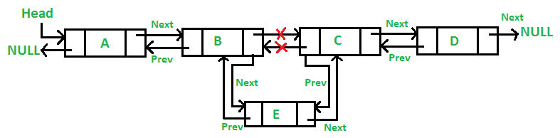
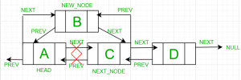
Doubly Linked Lists…
Insertion: After a given node : A 7 step process
Insertion: Before a given node: A 8 step process

Slide 37
END OF
UNIT-2

